Slide 1
Kenya Patient Pathway Model

Slide 2
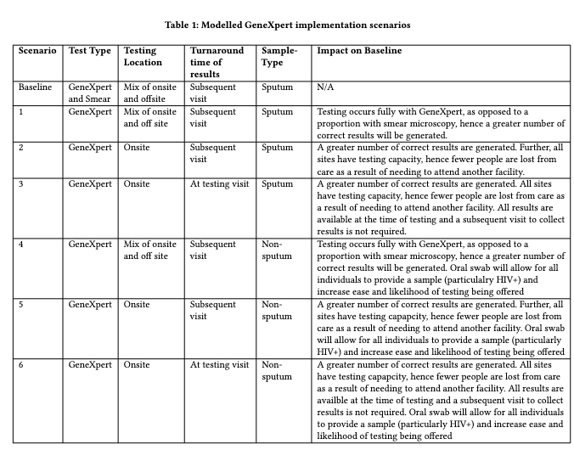
Scenarios
What case detection rates can be achieved through different implementations of existing diagnostic tools (namely GeneXpert)?
Key implementation considerations:
Offsite (centralised) vs onsite (decentralised) testing
Results returned at testing visit vs at a follow-up visit
Testing with sputum or non-sputum samples
Different implementations have an impact on access to testing and results and affects the number of individuals lost during diagnostic journey

Slide 3
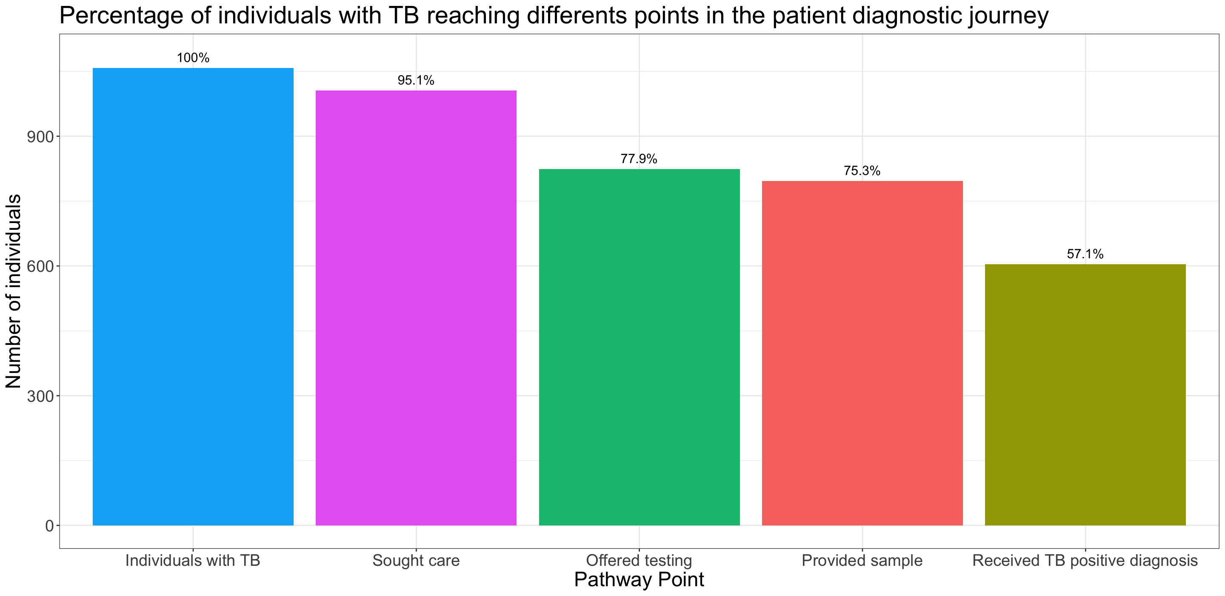
Baseline Results
Baseline case detection rate is ~57%
Decrease in number of individuals per stage is because of patient LTFU

Slide 4
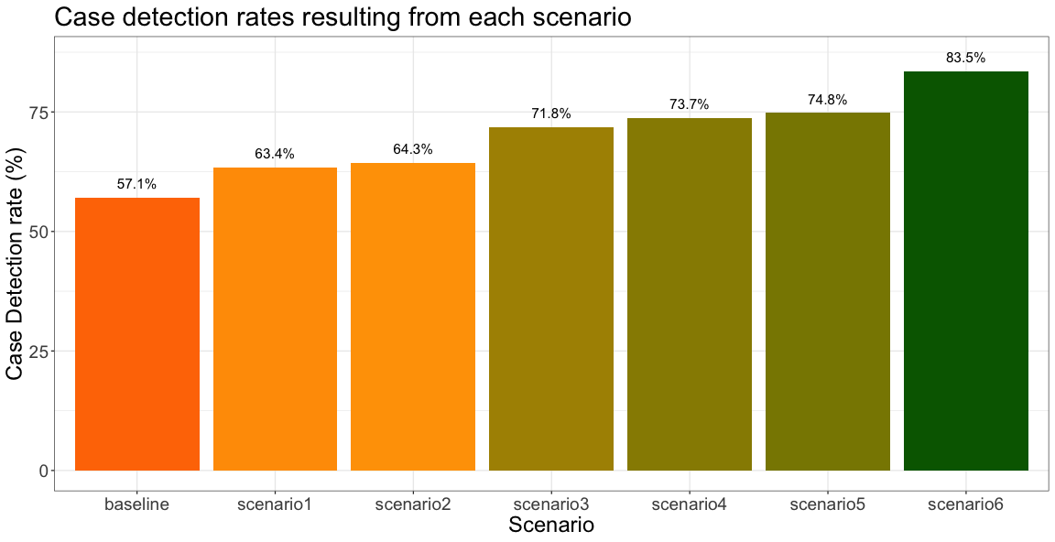
Scenario Results: Case detection
Used as inputs to dynamic experiments
Scenario | Case detection Rate | Change in CDR from baseline
Baseline | 57.09% | -
1 | 63.36% | 6.27%
2 | 64.35% | 7.26%
3 | 71.77% | 14.68%
4 | 73.73% | 16.64%
5 | 74.84% | 17.75%
6 | 83.49% | 26.40%

Slide 5
Cascade Rates

Slide 6
Kenya Baseline Transmission Model

Slide 7
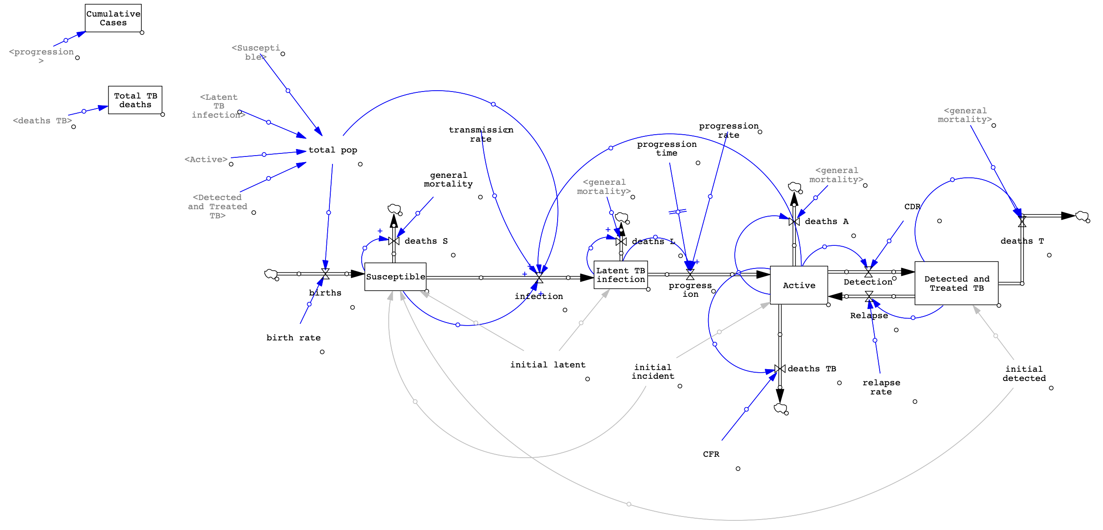
Baseline SFD

Slide 8
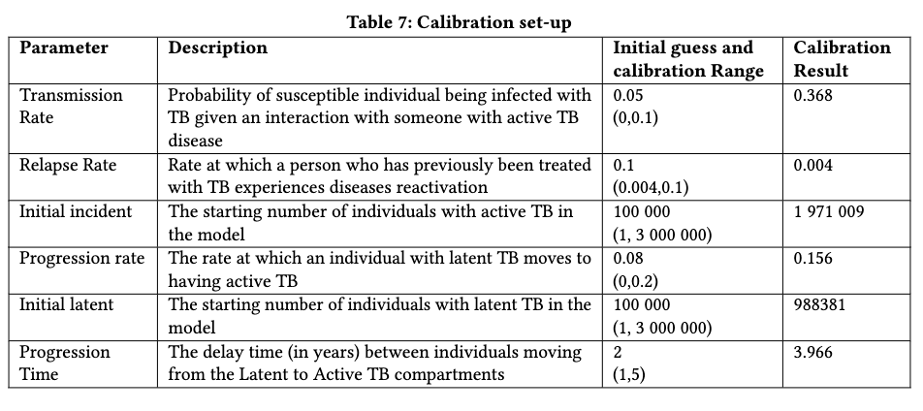
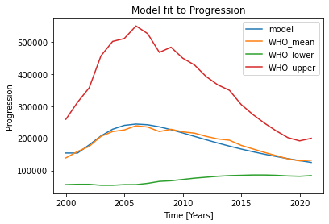
Baseline Calibration

Slide 9
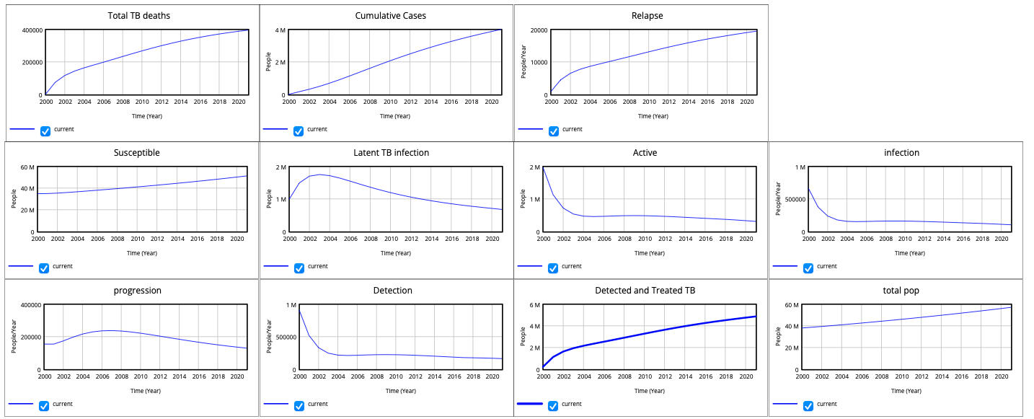
Calibrated Baseline Output

Slide 10
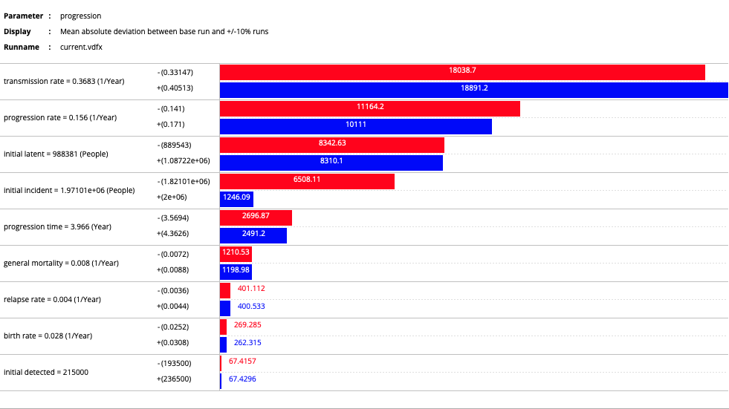
Tornado Plots: Progression

Slide 11
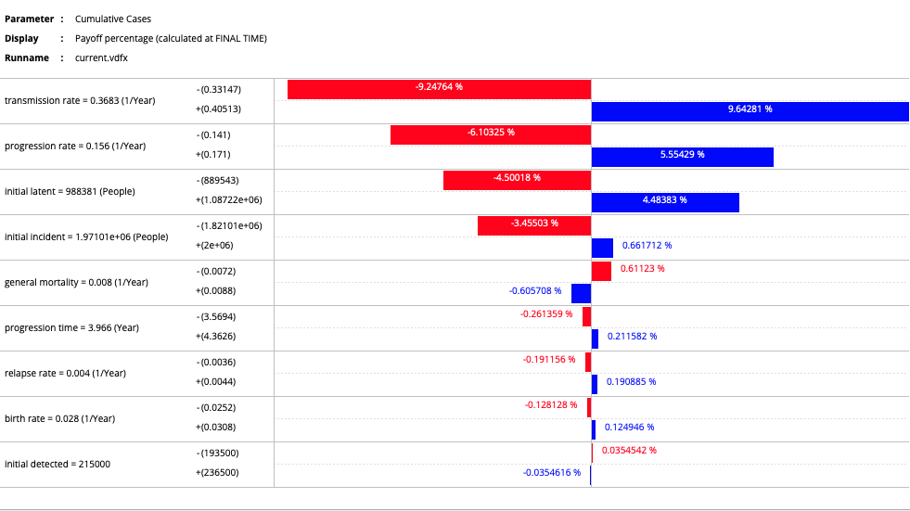
Tornado Plots: Cumulative New Cases

Slide 12
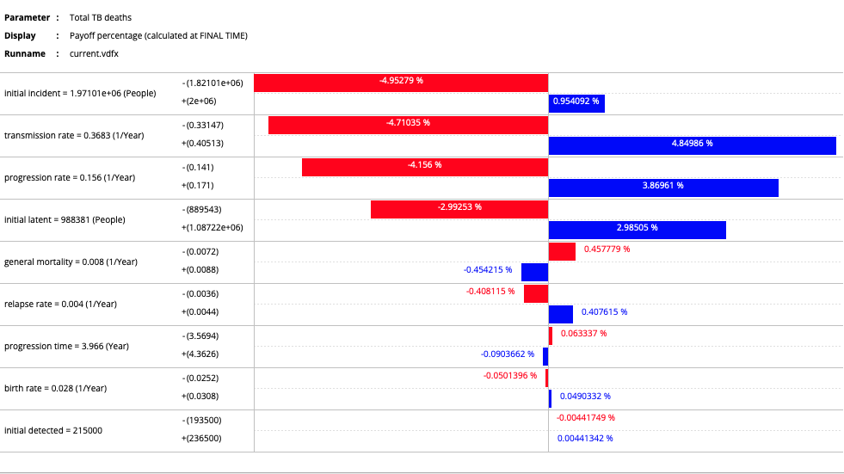
Tornado Plots: Total TB deaths

Slide 13
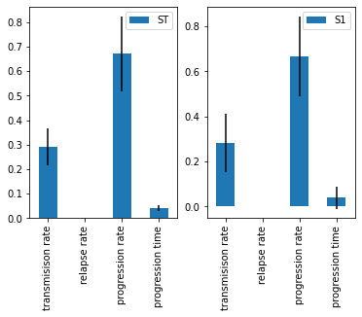
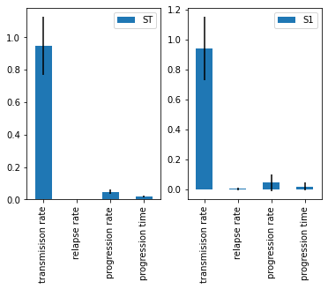
Sobel Indices: Progression
2005
2015

Slide 14
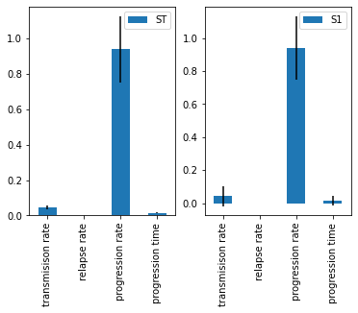
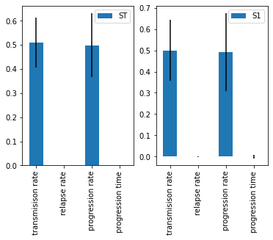
Sobel Indices: New Cases
2005
2015

Slide 15

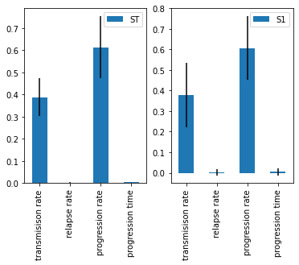
Sobel Indices: Total TB deaths
2005
2015

Slide 16
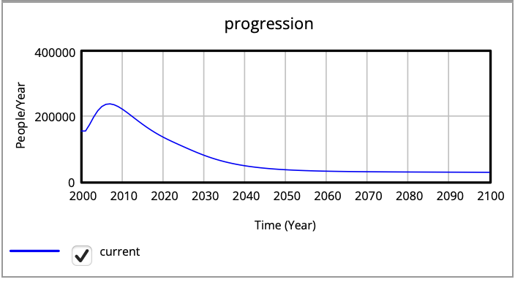
Dynamics/Equilibrium
Extend timeframe up until 2100
Consider flows – equilibrium is seen if flow =0 or is constant over time
Consider progression flow – new active TB cases
Although zoomed out it appears stable from around year 2060 – technically not in equilibrium as there is a slight decrease year on year
Likely that if the system remains as is, it may eventually reach equilibrium when progression reaches 0 – however this would likely require several hundred if not thousands of years
Year | Progression (people/year)
2060 | 31 173
2070 | 29 469
2080 | 28 672
2090 | 28 158
2100 | 27 711

Slide 17
Exp1: Increasing case detection rates
Consider the effect of increasing case detection rates over the next two decades (year 2041) on the total TB deaths, cumulative cases and progression (new cases)
Scenario (CDR increase) | Case Detection Rate (%) | Total TB Deaths | TB deaths averted | TB deaths 2041 (% change from baseline) | Cumulative Cases | Cases Averted | New Cases in 2041 (% change from baseline)
Baseline | 57 | 463 512 | - | 2190 (0%) | 5 583 870 | - | 43 965 (0%)
5% | 62 | 457 437 | 6 075 | 1825 ( - 16.7%) | 5 523 370 | 60 500 | 37 427 (-14.9%)
10% | 67 | 452 332 | 11 180 | 1542 (-29.6%) | 5 470 900 | 112 970 | 32 015 (-27.18%)
20% | 77 | 444 275 | 19 237 | 1138 (-48%) | 5 384 670 | 199 200 | 23 660 (-46.2%)
30% | 87 | 438 246 | 25 266 | 872 (-60.2%) | 5 317 040 | 266 830 | 17 596 (-60%)
40% | 97 | 433 593 | 29 919 | 689 (-68.5%) | 5 262 790 | 321 080 | 13 053 (-70.3%)
43% | 100 | 432 401 | 31 111 | 646 (-70.5%) | 5 248 570 | 335 300 | 11 910 (-72.9%)

Slide 18
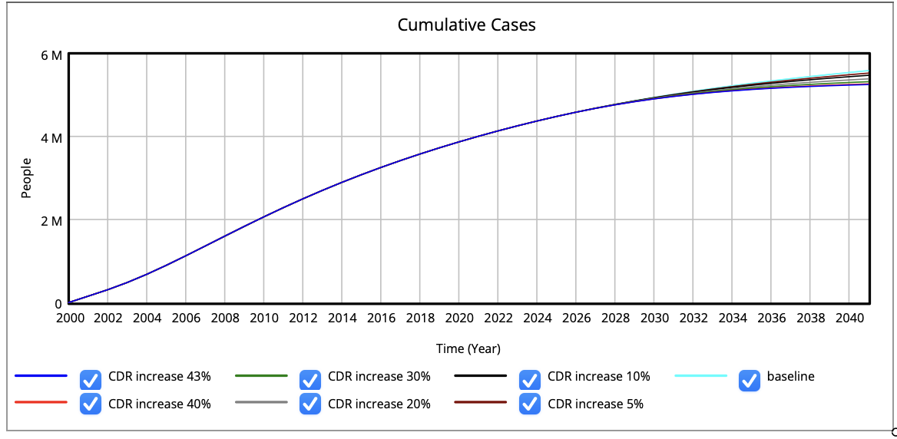
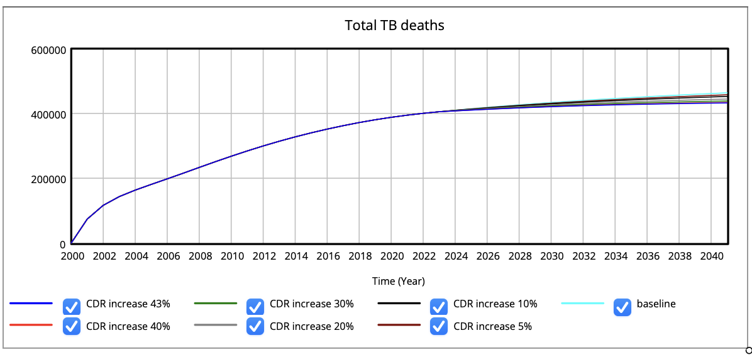
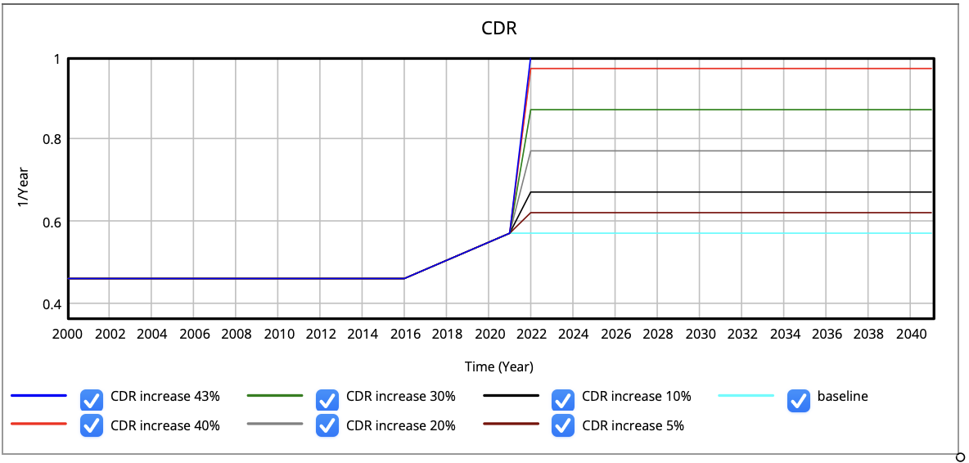
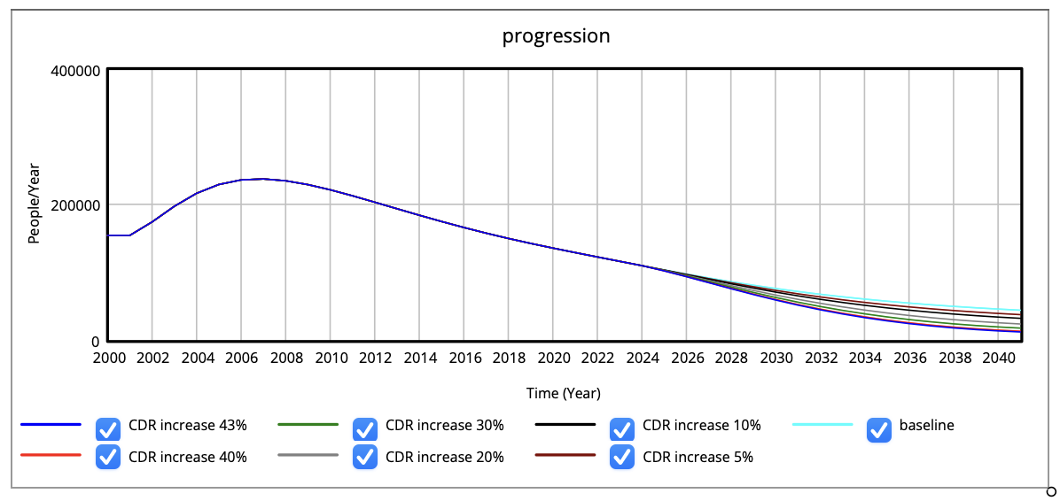
Exp1: Increasing case detection rates
Scale-up?

Slide 19
Exp2: Static scenario impact
Consider the long-term impact of the 6 different diagnostic implementation scenarios considered in the static analysis
Scenario | Case Detection Rate (%) | Increase in CDR from baseline | Total TB Deaths | TB deaths averted | TB deaths 2041 (% change from baseline) | Cumulative Cases | Cases Averted | New Cases in 2041 (% change from baseline)
Baseline | 57.1 | - | 463 512 | - | 2 190 (0%) | 5 583 870 | - | 43 965 (0%)
1 | 63.4 | 6.3 | 456 026 | 7 486 | 1 745 (-20.3%) | 5 509 020 | 74 850 | 35 923 (-18.3%)
2 | 64.3 | 7.2 | 455 085 | 8 427 | 1 693 (-22.7%) | 5 499 390 | 84 480 | 34 923 (-20.6%)
3 | 71.8 | 14.7 | 448 253 | 15 259 | 1 330 (-39.3%) | 5 427 800 | 156 070 | 27 753 (-36.9%)
4 | 73.7 | 16.6 | 446 744 | 16 768 | 1 256 (-42.7%) | 5 411 570 | 172 300 | 26 193 (-40.4%)
5 | 74.8 | 17.7 | 445 918 | 17 594 | 1 216 (-44.5%) | 5 402 610 | 181 260 | 25 342 (-42.4%)
6 | 83.5 | 26.4 | 440 231 | 23 281 | 956 (-56.3%) | 5 339 620 | 244 250 | 19 572 (-55.5%)

Slide 20
